Slide 1
Technology and computing class
Teacher Jennifer Restrepo

Slide 2
Agenda
01
02
03
04
Today is Monday, April 20th
Greetings
Class tools
And
Class rules
Essential standards
The Topic

Slide 3
Class tools
Zoom
Google classroom
Blog
Email

Slide 4
Class rules
First
Fourth
Second
Third
Be respectful and responsible
Avoid
using other devices
Self-Studying
Proper use of the chat

Slide 5
Technology class
Essential standards
Second school term

Slide 6
Problematizing question
Knowing how to know
Why is it important to have skills in order to handle electronic data and using Microsoft Office tools?
Knowing how to do
Knowing how to be
I am able to identify differences between files and folders to store data, besides, I can recognize the structure of a written paper attending to basic APA standards.
I am able to develop an innovative and attractive entrepreneurship project proposal and I interact with various options offered by Virtual learning environments.
I am respectful within virtual learning environments and responsible for the delivery deadlines of academic activities.

Slide 7

Word processing software:
Microsoft word

Slide 8
Creating your folder
01
02
03
04
Go to “Documentos”
Click on “Nueva carpeta”
Name your folder
Press intro

Slide 9
Word processing program vs. text editor
A text editor is not a word processor
A word processor typically does more than a text editor. Besides adding text to a file, most word processing programs allow you to control the appereance of the text (e.g paragraph styles, fonts)
A word processor allows you to:
Creat, format, edit, store and print typed documents

Slide 10
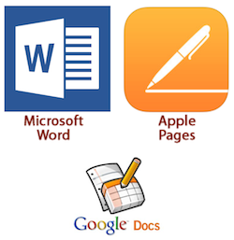
Most popular word processors

Slide 11

Most popular word processors
Sometimes called Winword, MS Word, or Word, Microsoft Word is a word processor published by Microsoft. It is one of the office productivity applications included in the Microsoft Office suite. Originally developed by Charles Simonyi and Richard Brodie, it was first released in 1983.

Slide 12
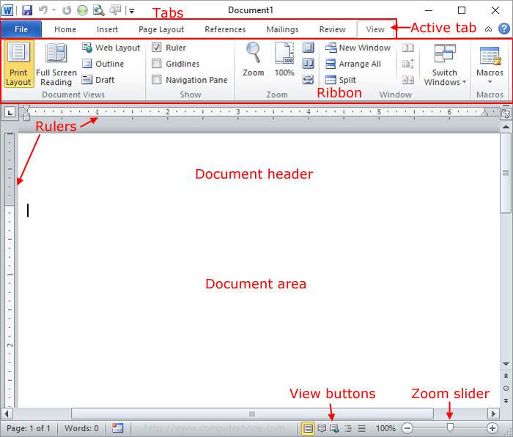
How does microsotf word look like?
In a word processor, you are presented with a blank white sheet. The text is added to the document area and after it has been inserted formatted or adjusted to your preference.

Slide 13
Word processing vocabulary
Edit: Modify a document.
Store: Save a document.
Print: The impression of a document.
Type: Write documents using an electronic device.

Slide 14
Practice
?
Create a document using the text editor of Microsoft and another document using Microsoft Word, type 5 characteristics of each program.

Slide 15
THANKS!
Do you have any questions?
youremail@freepik.com
+91 620 421 838
yourcompany.com
Please keep this slide for attribution.

