Slide 1
Technology and computing
Sixth week

Slide 2
Today is Tuesday, July 14th 2020
Agenda
Greetings
And attendance
2. Practice storing on folders
4. Workbook:
3, 4, 5, 6, 7, 8
5. Closure

Slide 3
Save a picture of your favorite video game to your
“School” folder.

Slide 4
Workbook
Sixth week

Slide 5
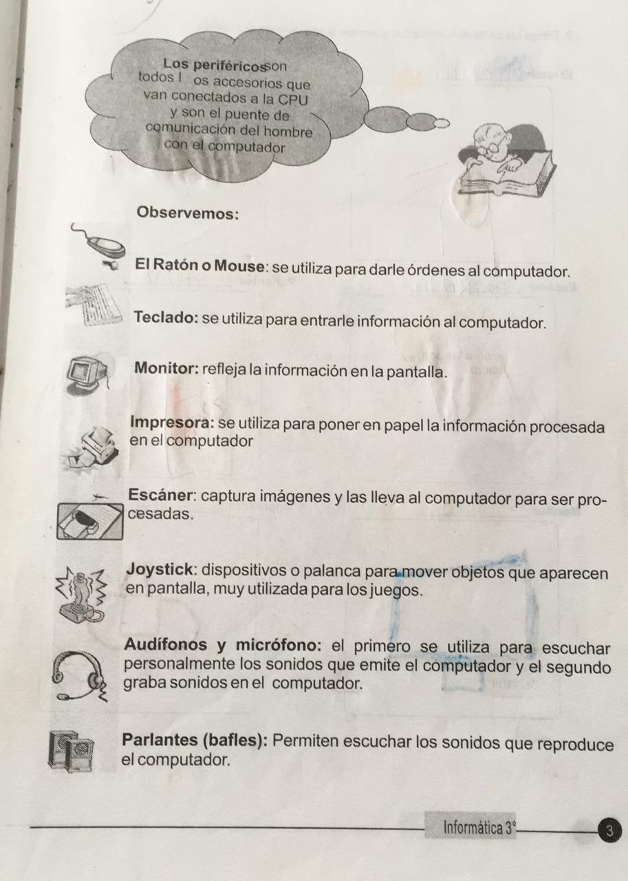
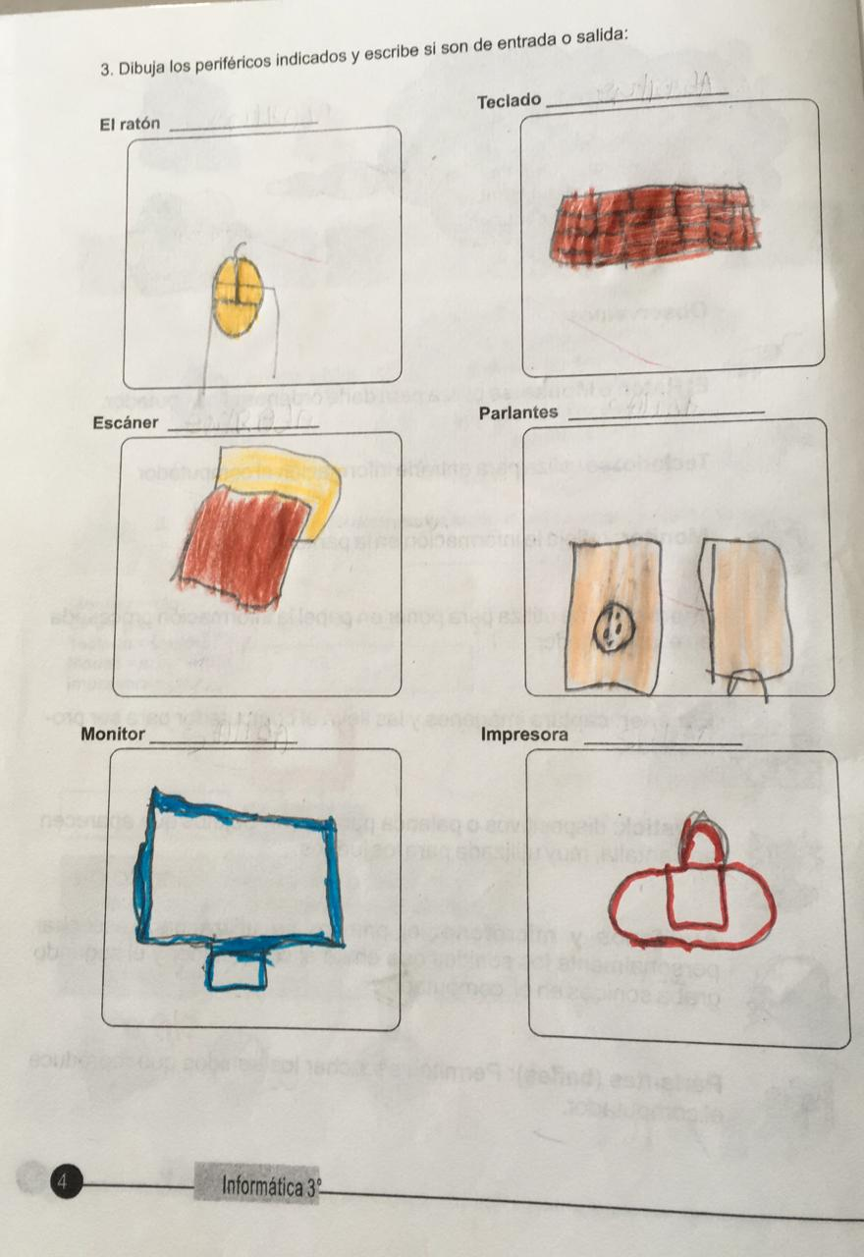
Pages 3 and 4 Input and output
Mouse
Keyboard
Speakers
Scanner
Printer
Monitor

Slide 6
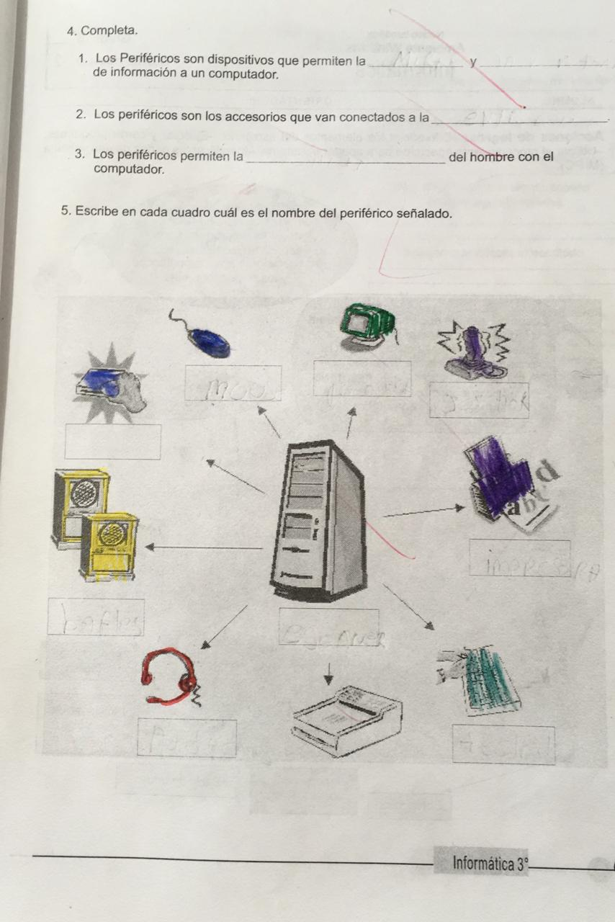
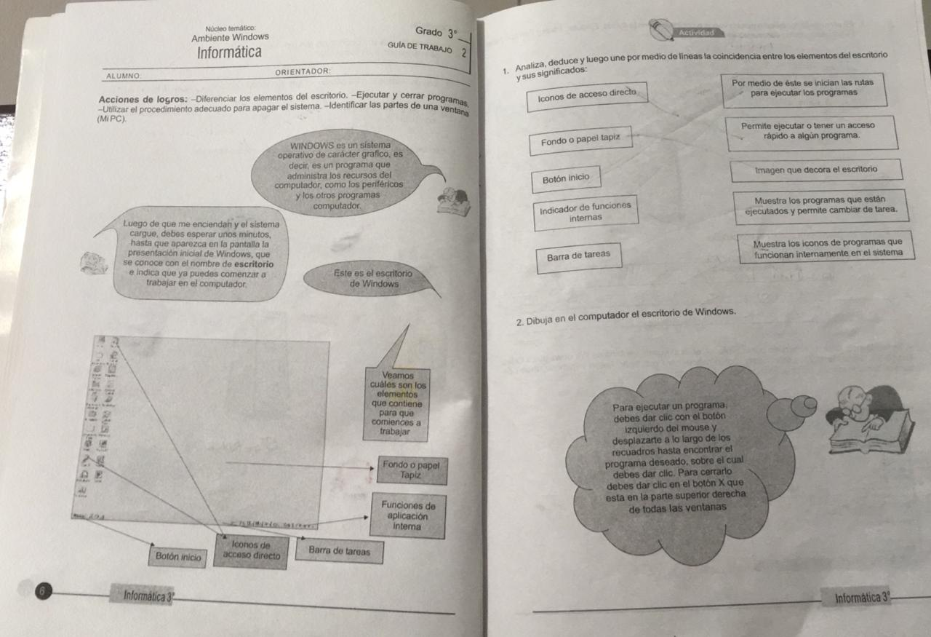
Pages 5 and 6

Slide 7
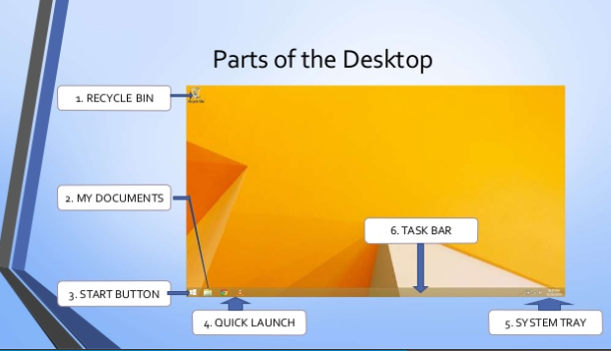

Slide 8
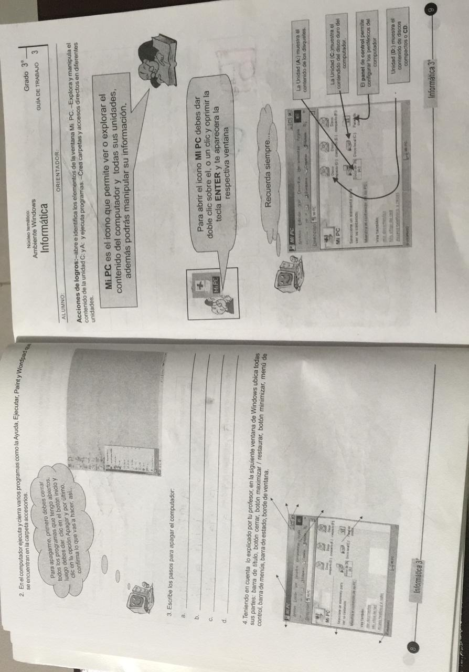
Pages 7 and 8

Slide 9
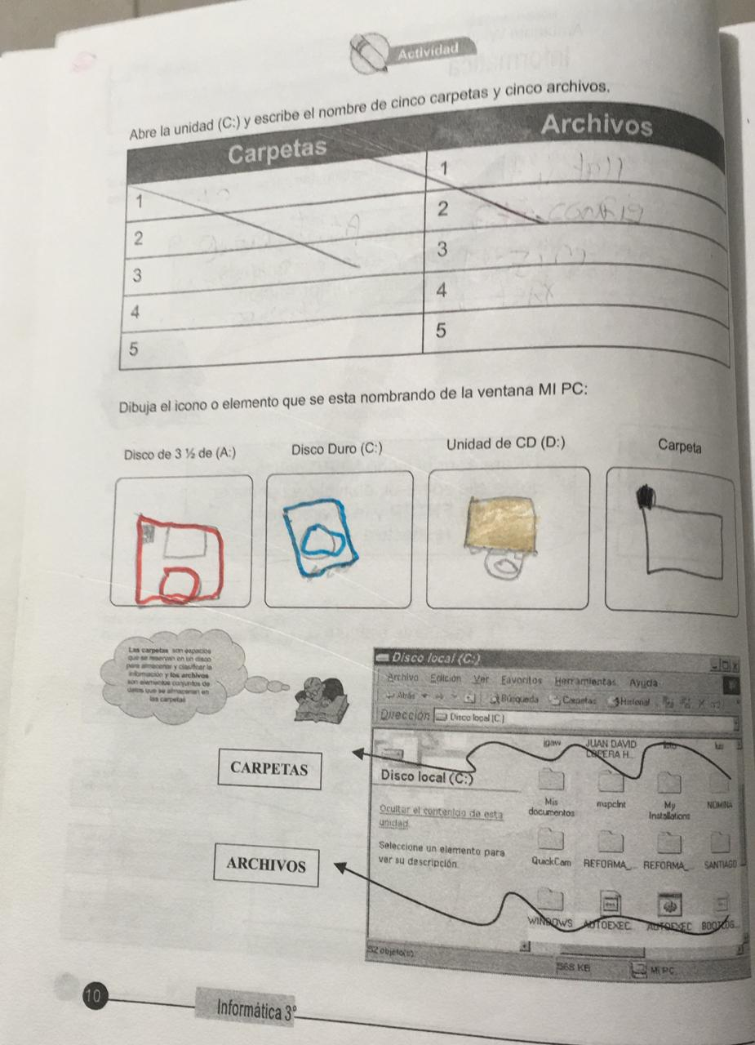
Pages 9 and 10

