Slide 1
Technology and computer science

Slide 2
Agenda:
01
Greetings
03
Practice
Topic:
Word processing programs
02
04
Closure

Slide 3
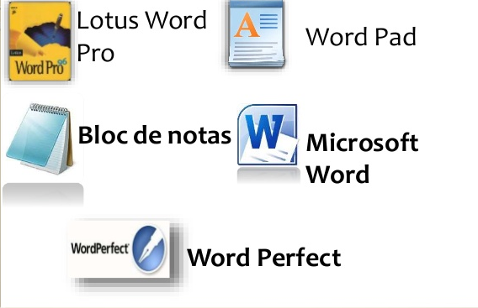
What is a Word processing program?
A Word processing program is an electronic tool or software that allows you to create, and modify a text document using an electronic device such as computers, tablets, or even smartphones.

Slide 4
Main functions:
Creation: It allows you to generate every kind of text, simple or complex.
Edition: It allows you to perform modifications on the document: size, color, alignment, columns, etc.
Save: It allows you to store the text on your computer or external pen drive (USB).
Print: It is necessary to use a printer in order to get our document, that’s why text processing programs must be compatible with printers.

Slide 5




Most known softwares
Pages: Is a text editor compatible with Word, in order to generate PDF, HTML or RTF documents. It is available for MACOS.
Microsoft Word: The best know word processor for Windows computers.
Apache OpenOffice Writer: This Word processing software is part of OpenOffice Suite, which has an open code.
Google Docs: Is a Word processing software included within free Google editor softwares offered by Google.

Slide 6
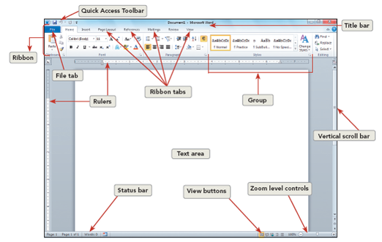
Working area

Slide 7
Activity
Using the font menu, inserting images and shapes, we will create a poster about good hand washing to avoid coronavirus.

Slide 8
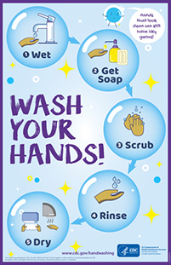
Example

Slide 9
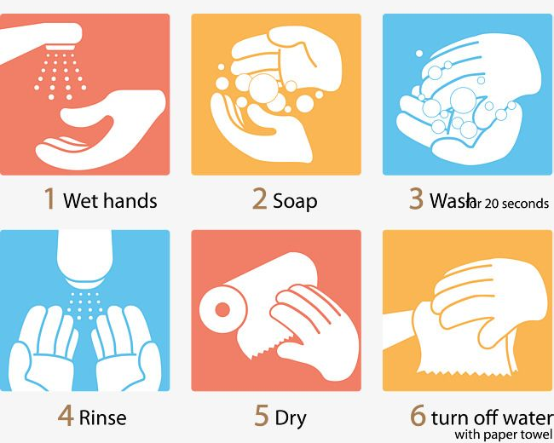
Steps to wash your hands

