Slide 1
Technology and computing
Grade 5°

Slide 2
Agenda
01
Self-assessment
02
Topic: Basic Windows settings
03
Practice
04
Post evidences and closure

Slide 3
Main Windows settings
How many versions does Windows have?
01
02
Recognize the version of the operating system
Set up
Date and time, volume settings, background, resolution. -
03
04
Change, add, delete a keyboard language. Change the default language.

Slide 4
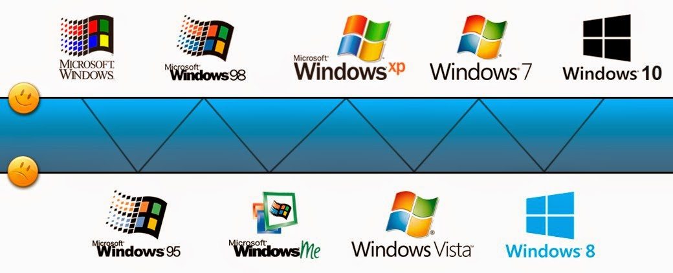
Versions of Windows
2020
2021
2022
2023
2024
1
2
3
4
5

Slide 5
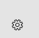
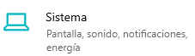
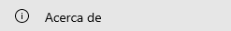
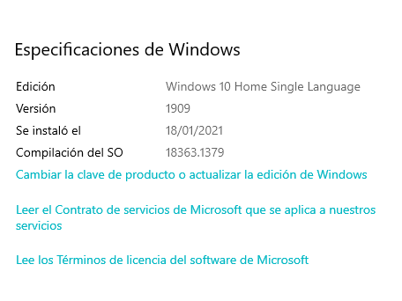
How to check your Operating system’s version?
Go to the start menu and locate the icon of settings:
Select the “Sitema" option:
In the menu on the left, you will find configuration options, choose “Acerca de"
At the bottom of the right side, you will see the version of your
Operating System: This section is called “Especificaciones de Windows"

Slide 6
Why is it important to recognize the version of your operating system?
Knowing which version of Windows you use on your computer is basic, but it is also very important. Every six months, approximately, an update is released that elevates the version of Windows 10 and introduces various changes, which can affect both the interface and design elements and specific functions. Having a newer version of Windows 10 generally means more advanced features and a more complete operating system.

Slide 7
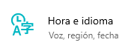
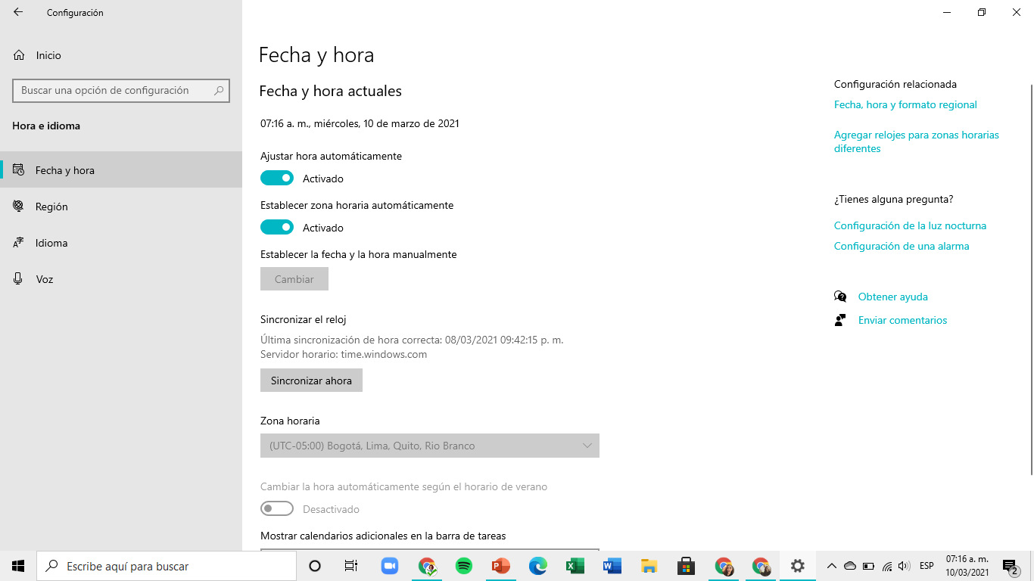
Date and hour settings
1
2
3
4
5
Date and hour
Date and hour
Region
Language
Voice
In the same settings menu, select “Hora e idioma"
Allows you to set the time zone and time manually or automatically
It allows to identify the language of the operating system, add another language to the keyboard and prioritize them
Allows you to set the voice language, voices, microphone voice
Allows you to set the country and place where the equipment is located, in order to offer the available applications and features.

Slide 8
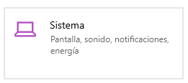
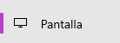
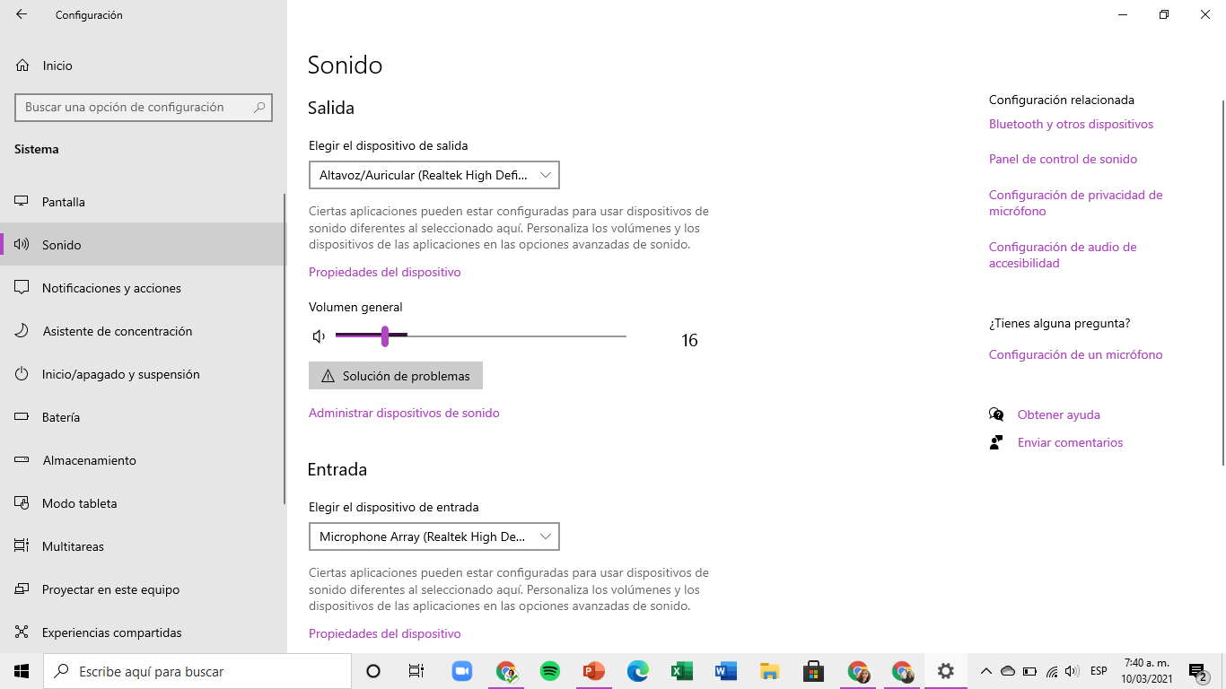
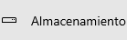
System settings
01
02
Screen
Sounds
Change brightness and color, Scale and layout, resolution, connect to automatic projection
Input and output devices, application and system volume
03
04
Start/
Off/
Suspension
Storage
Free up space, View storage usage, hard drive capacity
Determine when to turn off screen or suspend

