Slide 1
Welcome to second term

Slide 2
Today is Monday, March 15th 2021
Agenda
1. Greetings
2. Completing activity about operating systems
3. Cover page and standards

Slide 3
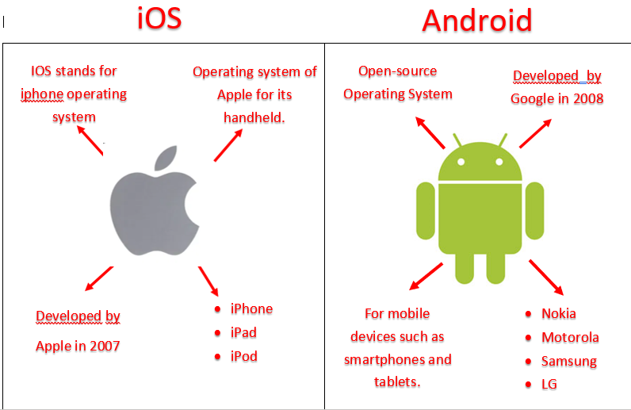

Slide 4
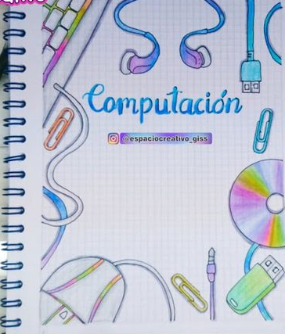
Second
School term

Slide 5
Problematizing question
How can I generate and store information to electronic means?

Slide 6
Knowing how to know
I am able to identify available electronic means in my environment for the development of various activities (communication, entertainment, learning, searching, researching and validating information, etc.)

Slide 7
Knowing how to do
I am able to use word processing programs correctly, when preparing different types of written documents.

Slide 8
Knowing how to be:
I am able to manifest a propositional attitude during the development of the classes and when interacting with my classmates.

Slide 9
Conceptual domains
Types and classification of technological tools.
2. Internal data storage units and handling files and folders: saving, deleting files and folders
3. Technology in transportation .
4. Paint 3D: Using 3D images library, simple illustrations, handling desing tolos.
5. Calculator: Basic operations and using online calculator.
6.Types of Word processing programs: Differences and similarities.

