Slide 1
Technology and computing

Slide 2
Agenda
Greetings
01
02
Second term:
Cover and standards
Topic: Data storage devices
03
04
Practice

Slide 3
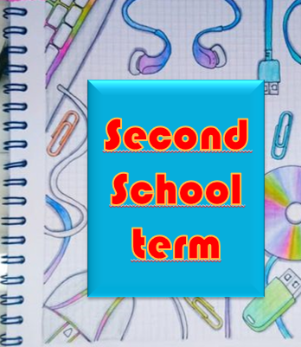
Cover page

Slide 4
Problematizing question
Why is it important to have skills in information management and the use of office tools?

Slide 5
Knowing how to know
I am able to identify external data storage units, folder’s structures, and the function of photovoltaic cells.

Slide 6
Knowing how to do
I am able to use the guide keyboard effectively and can correctly edit my electronic documents.

Slide 7
Knowing how to be
I am respectful and participate with interest in virtual or face-to-face academic activities, in the same way, I contribute with my ideas to the development of classes.

Slide 8
Conceptual domains
1. Creation of folder structures, saving and retrieving information in a retrievable memory. External storage drives and folder structures.
Backups.
2. Concepts of copy, paste, move in retrievable memory.
3. Save a document to a location on a drive
storage.
4. Save a document under a different name to a location on a storage drive. Save and save as.
5. Word processing program:
Management of line spacing, Numbering, Bullets, Margins, alignment, Columns, capital letter, background, images, shapes.
6. Solar energy, operation of solar panels (photovoltaic cells).
7. Keyboard: guide keyboard
8. Functions of an entrepreneur

Slide 9
What does the term store refer to?
Have you heard about data storage devices?

Slide 10
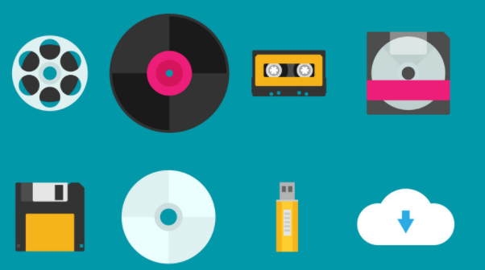
What are data storage devices?
They are devices that allow the input and output of information, in which the system deposits certain data for later retrieval. Can be of various types, depending on the type of mechanisms used to store the information.

Slide 11
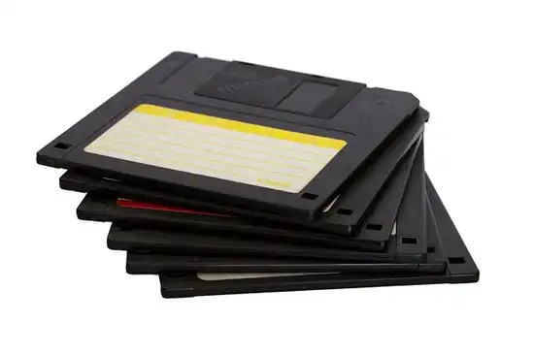
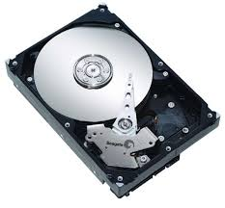
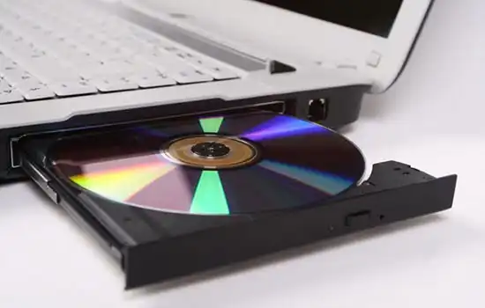
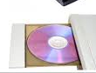
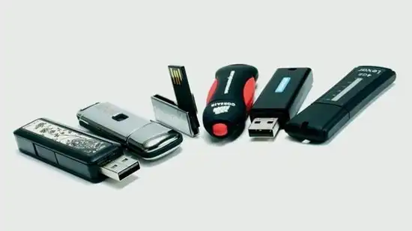
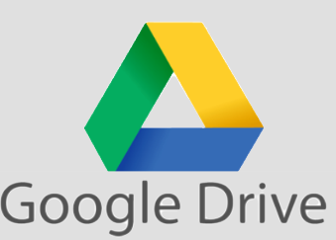
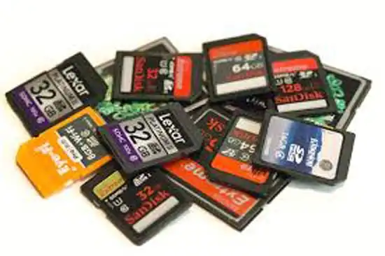
Classification
1
2
Magnetic
Storage
Optical storage
They store multimedia files, such as music, photos, and videos.
They allow the storage of large amounts of information in small volumes.
3
4
Electronic
Means
The cloud
All the information that we need to store or protect is stored in a remote physical space, requires an internet connection.
They use electronic circuits to store information, which do not need to move to perform this function.

Slide 12
Activity
Search 2 examples per each type of data storage device, draw them in your notebook and write down their names.

