Slide 1

Technology and computer science
Teacher Jennifer

Slide 2
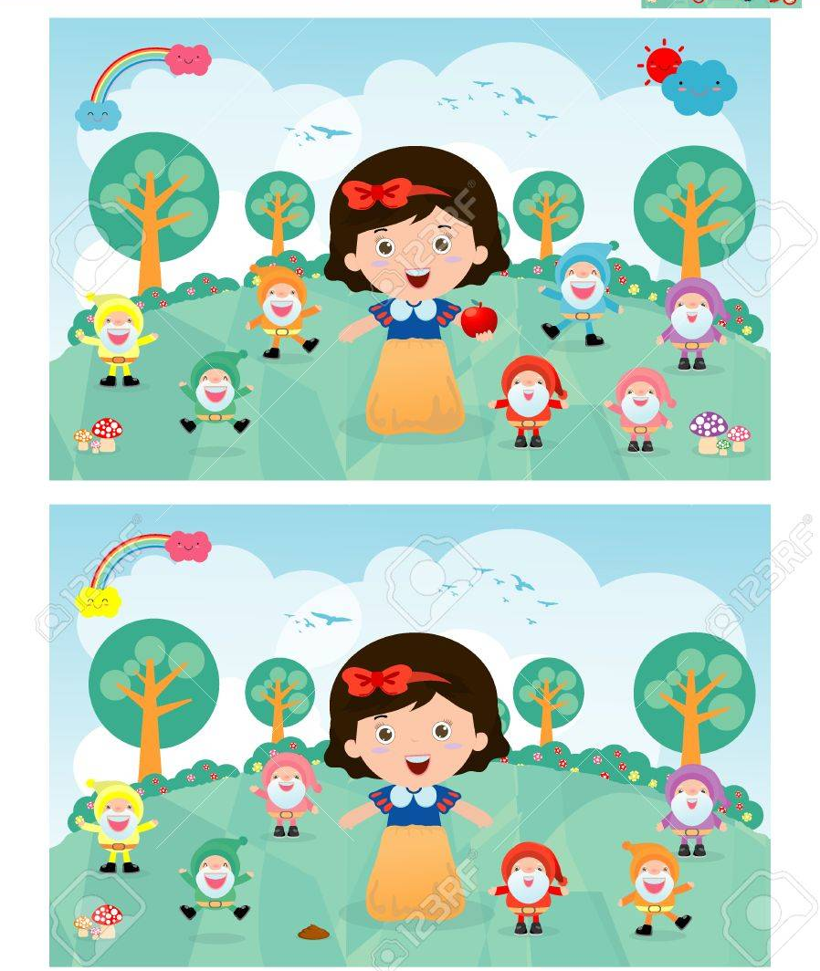

Slide 3

Week 3 second term
Agenda:
1. Greetings
2. What are files and folders?
3. Activity: False or true
4. Create a folder for technology

Slide 4
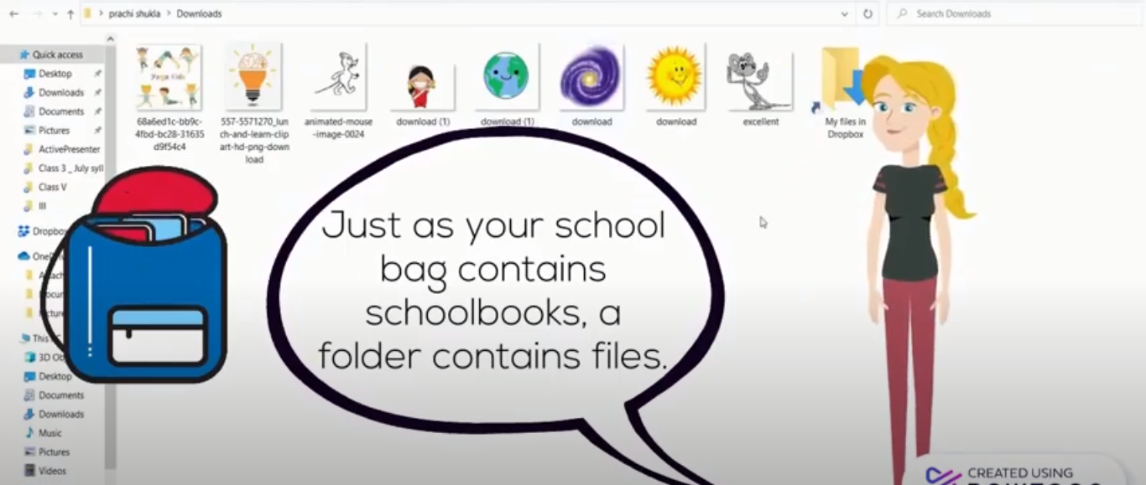
https://youtu.be/iMZfLgnU0VI

Slide 5
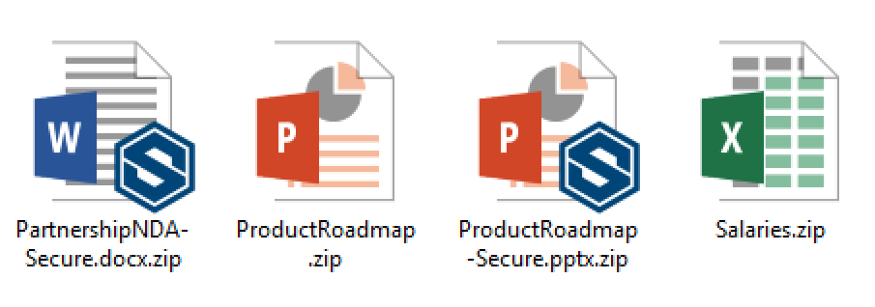
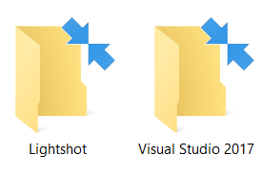
What are files and folders?
File:
Is the common storage unit in a computer, and all programs and data are "written" into a file and "read" from a file. Files are represented by icons on the desktop.
Folder:
Holds one or more files, and a folder can be empty until it is filled. A folder can also contain other folders, and there can be many levels of folders within folders.

Slide 6
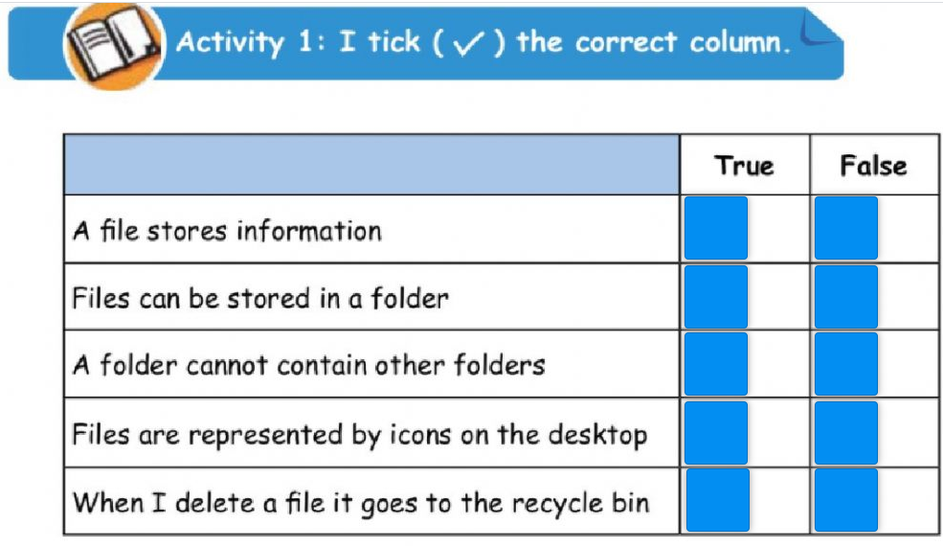
https://www.liveworksheets.com/jp1503610de

Slide 7
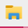
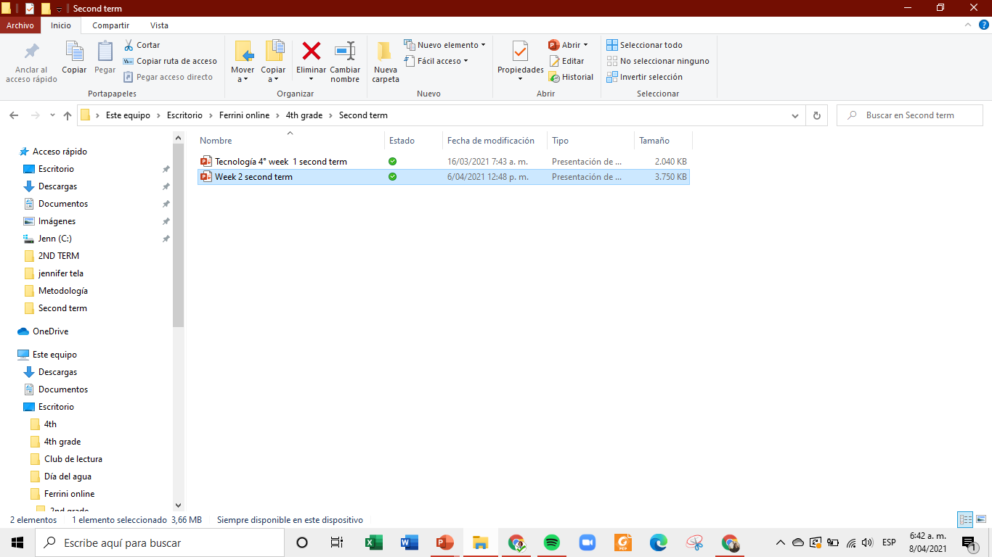
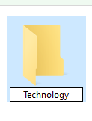
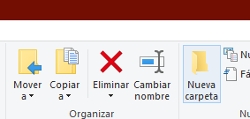
How to create a folder using file explorer tool?
1. Go to Your file explorer:
2. Select “Escritorio” or desktop on the left-side:
3. Select “Nueva carpeta” or New folder
3. Name it and press enter key

