Slide 1
Technology
Week 7
Teacher Jennifer

Slide 2
Agenda
01
03
02
04
Page setup:
Title page
Font style
Margins/ Line spacing
Alignment/indentation
APA 7th edition
Exercise
Order of pages

Slide 3
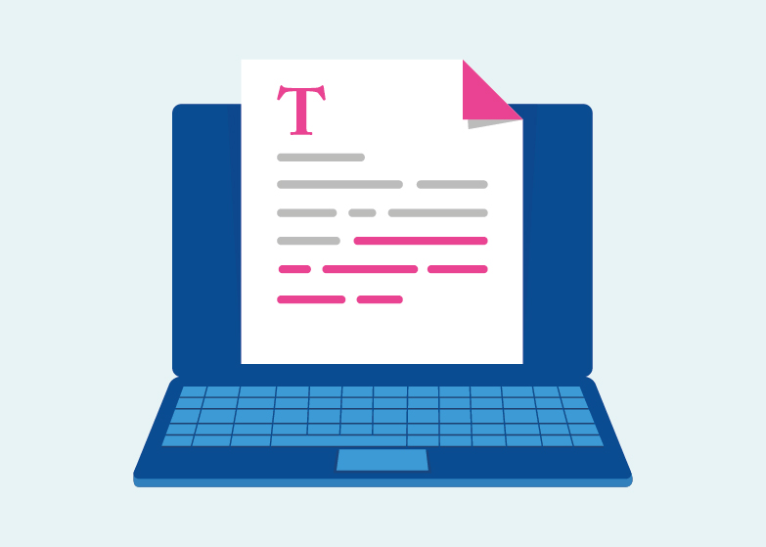

Apa 7th edition
Consistency in the order, structure, and format of a paper allows readers to focus on a paper’s content rather than its presentation.
To format a paper in APA Style, writers can typically use the default settings and automatic formatting tools of their word-processing program or make only minor adjustments.

Slide 4
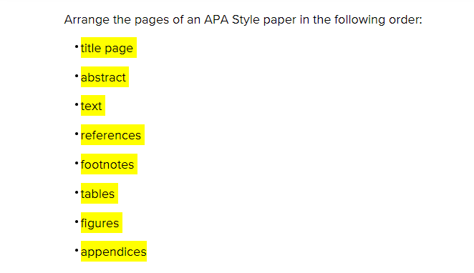
Order of pages

Slide 5
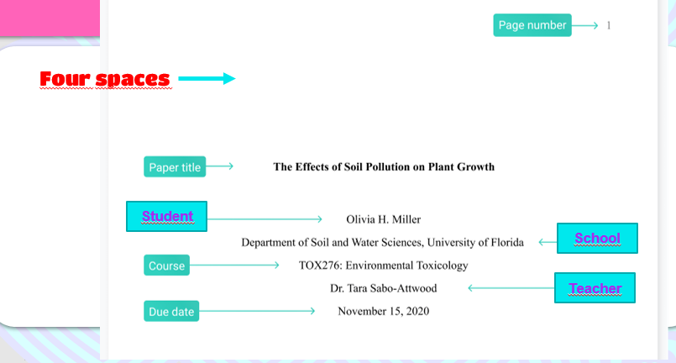
Title page

Slide 6
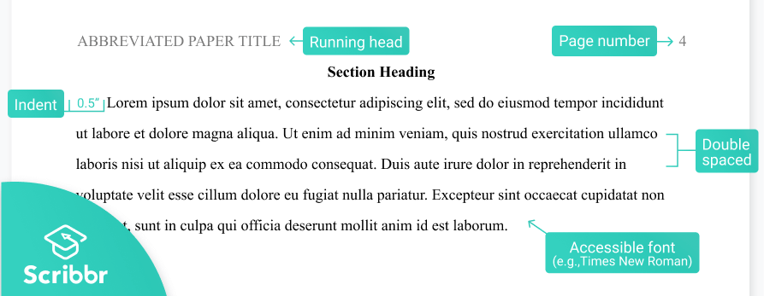
Content of text

Slide 7
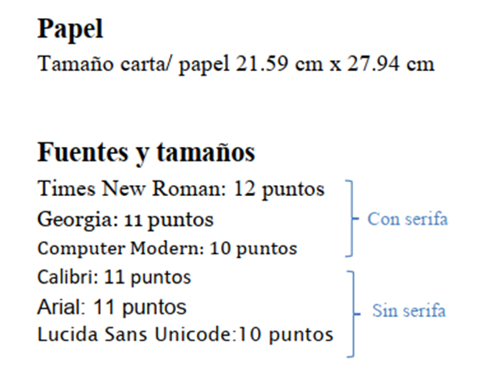
General format
Paper
size
Fonts

Slide 8
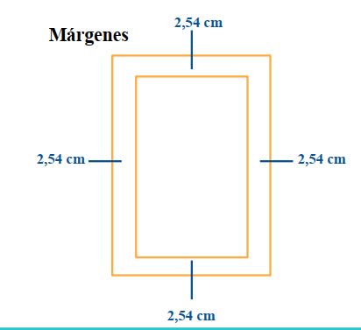
MARGINGS

Slide 9
Paper settings
MS Word:
https://www.youtube.com/watch?v=PWA8NQwvoH0
Google Docs:
https://www.youtube.com/watch?v=1M4UgvcXtKs&ab_channel=AmyWhitson

Slide 10
Activity
Based on the story you like the most, answer:
Which are the main characters?
What is the conflict?
Where does it take place?
If you could change the ending, what would it be?
Upload the file to Drive.

