Slide 1
Week 19
4th grade
Technology

Slide 2
Agenda
01
02
03
04
Greetings and brainstorming
Topic: physical failures and virus-
Closure
Practice:
Mind map about the topic

Slide 3
01
Have you ever observed a hardware failure in your devices? What changes do you see on your device?

Slide 4
Hardware failures
Hardware are the components that make up computer equipment (Graphics Card, Power Supply, Ram Memory, Processor, Motherboard ...); A hardware error is a failure in one of these components.

Slide 5
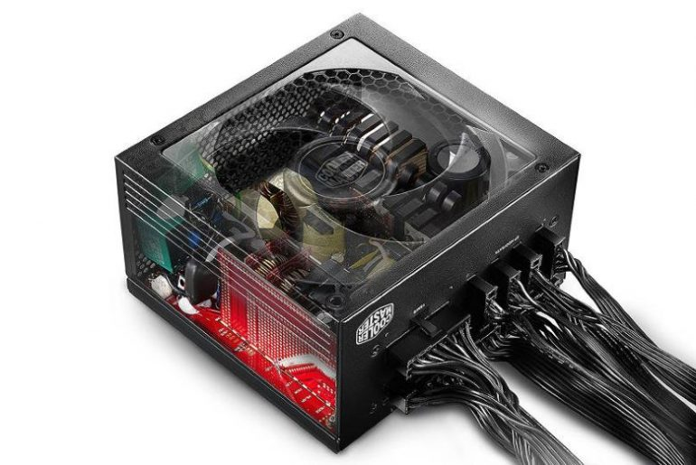
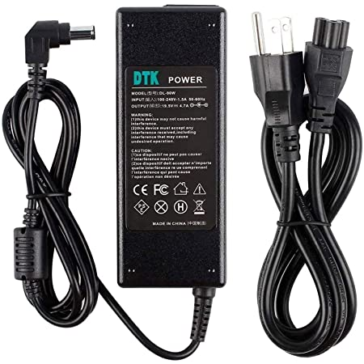
Power supply failure
The power supply is in charge of providing energy in a stable way to all the components of the equipment; If this is not done properly, any of these components can be affected and become unstable.

Slide 6
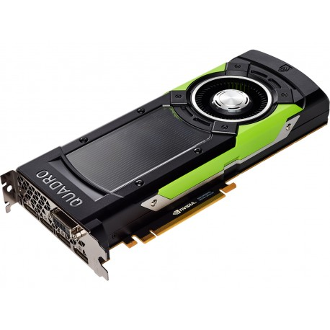
Graphic card failure
There are times when it is easy to associate a computer error with a VGA malfunction: The computer beeps when you try to turn it on. The computer starts up, starts up, but nothing is visible on the monitor. Vertical stripes appear on the monitor. Other times the computer becomes unstable when it has been running for a while or a multimedia application is running (the graphics chip overheats).

Slide 7
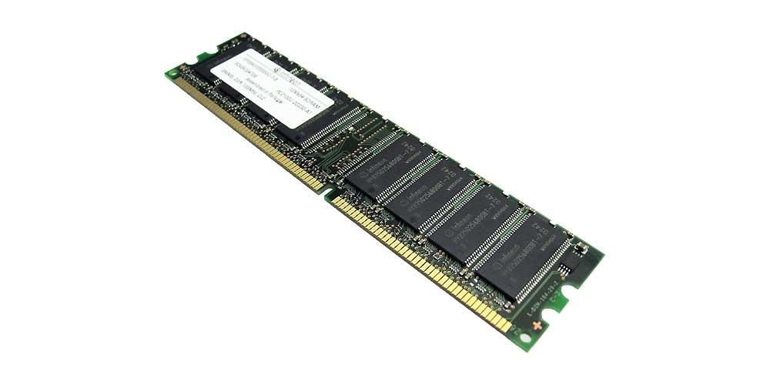
RAM memory failures
When the memory module is in very bad condition the computer does not start and usually beeps when you press the power button.

Slide 8
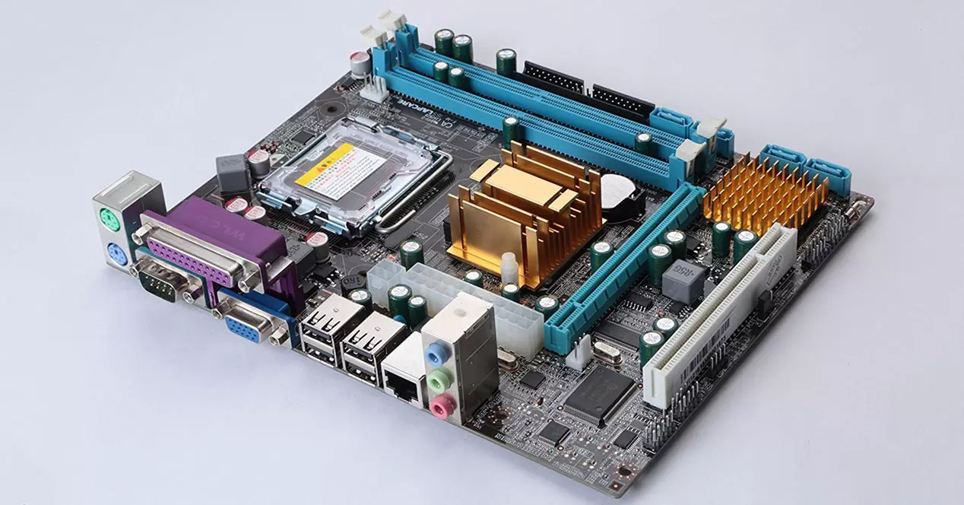
Motherboard failures:
The most common failures in motherboards are usually due to capacitor failure, short circuits or damaged tracks. In most cases they are repairable electronically.

Slide 9
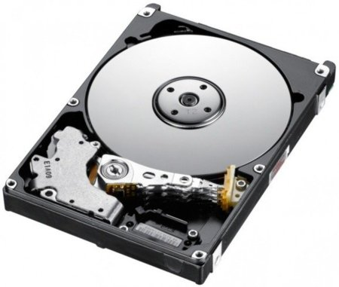
Hard drive failures:
There are two types of failures in mechanical hard drives: logical and physical. The logical ones are due to failures in the file system and the physical ones to errors in some of the components that make up the disk. The most common failure of a hard drive is deterioration of the magnetic surface.

Slide 10
What is malware?
Malware, short for malicious software, is a blanket term for viruses, worms, trojans and other harmful computer programs hackers use to wreak destruction and gain access to sensitive information.

Slide 11
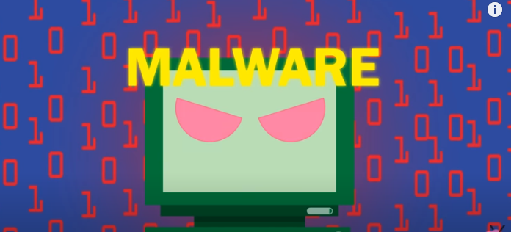
Malware
https://youtu.be/AfZxUK9U3hE

Slide 12
Practice
Create an infographic about hardware failures and malware using MS Word
https://www.youtube.com/watch?v=zSPe9QDg4dI&ab_channel=Massarik

